Slide 1

TESLA COIL USING LT SPICE
GROUP 16
Sanjana Shetty (23UGENG1559)
R.Sonali(23UGENG1174)
Saptami Nandish(23UGENG1117)
B8, I SEM
First Year 2023-24
DAYANANDA SAGAR UNIVERSITY

Slide 2
OUTLINE
Introduction
Objectives
Proposed methodology
Team structure
Working methodology
Outcomes
Conclusion

Slide 3
INTRODUCTION
What is Tesla Coil?
A Tesla Coil is an electrical resonant transformer circuit designed by inventer Nikola Tesla in 1891.
It is used to produce high- voltage ,low current, high-frequency alternating current electricty.
Energy is transferred from primary to secondary by carefully adjusting the coupling and secondary is tuned at resonance to achieve maximum voltage.

Slide 4
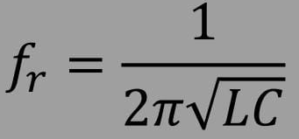
OBJECTIVES
Tesla coil are unique in the fact that they create extremely powerful electrical fields.
To calculate :
L IS INDUCTOR
C IS CAPACITOR
f-IS RESONANT FREQUENCY

Slide 5
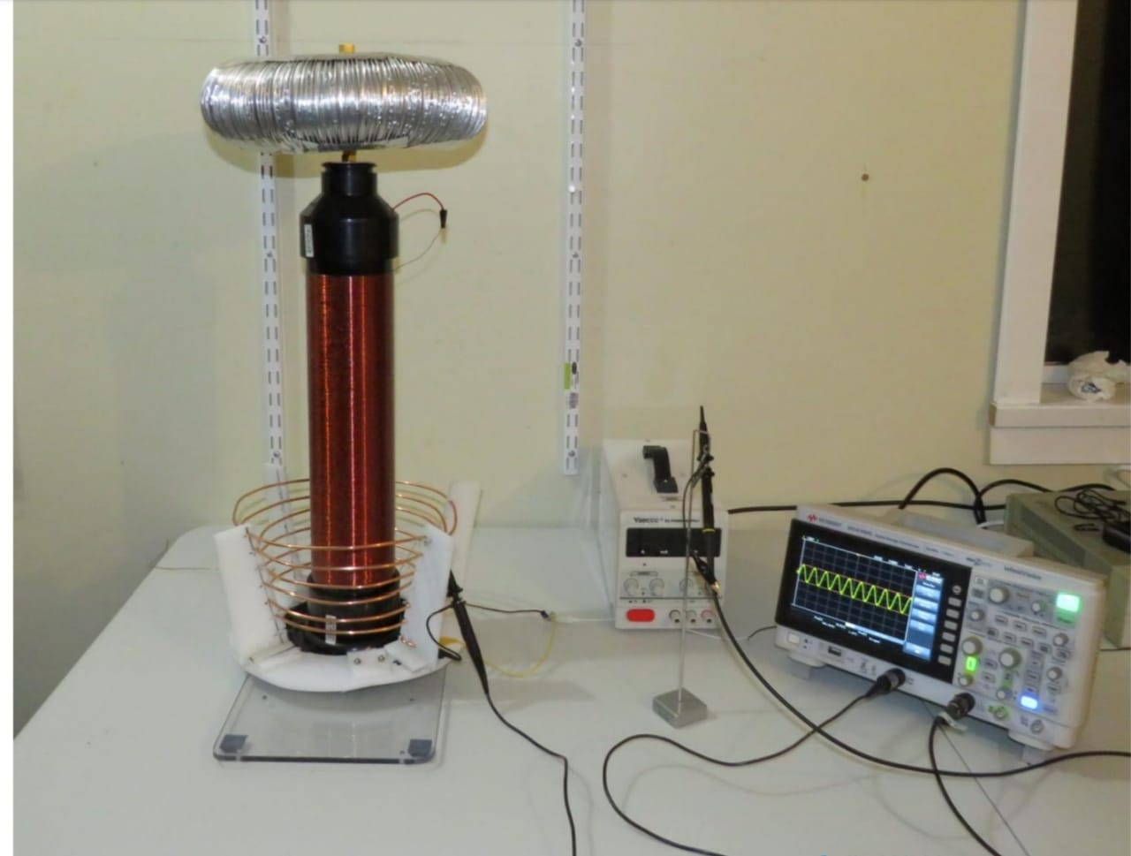
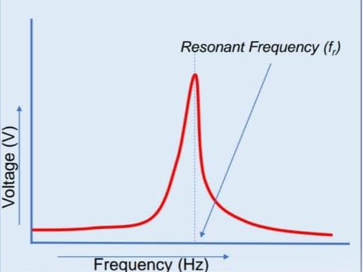
PROPOSED METHODOLOGY
EXPERIMENTAL SETUP OF TESLA COIL

Slide 6
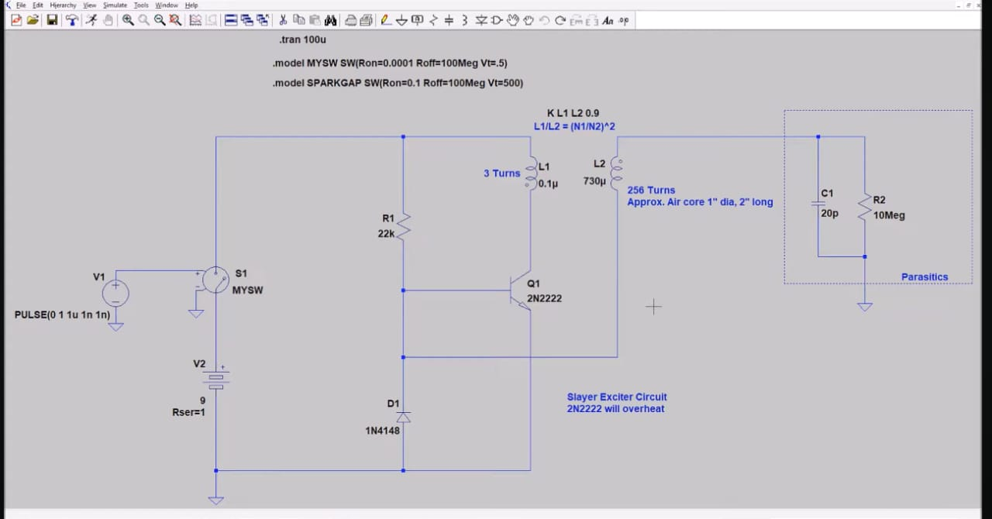

Slide 7
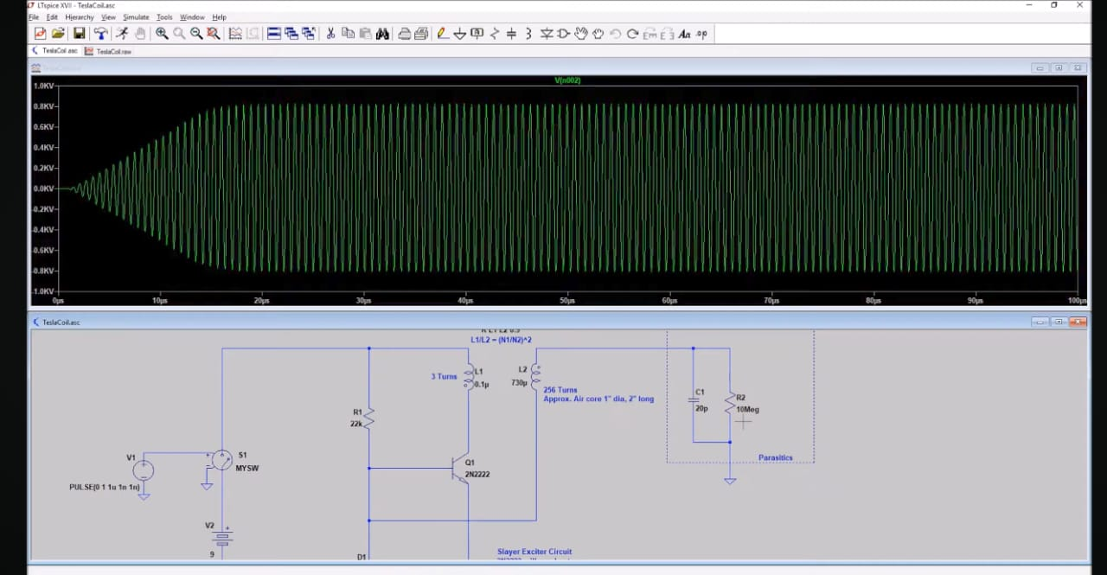

Slide 8
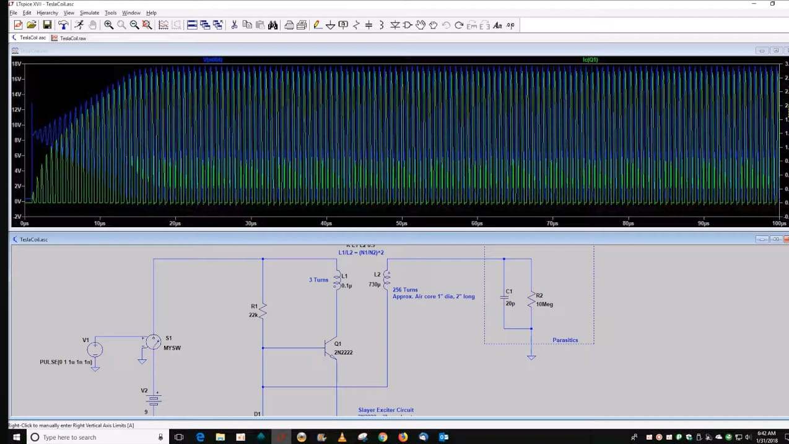

Slide 9
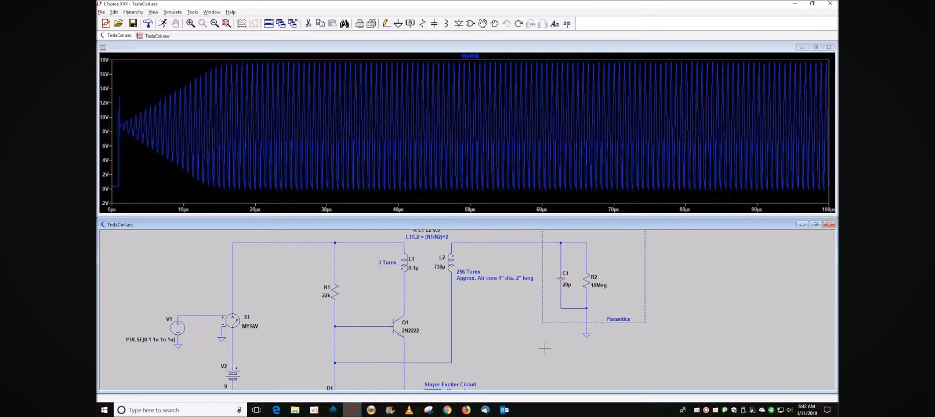

Slide 10
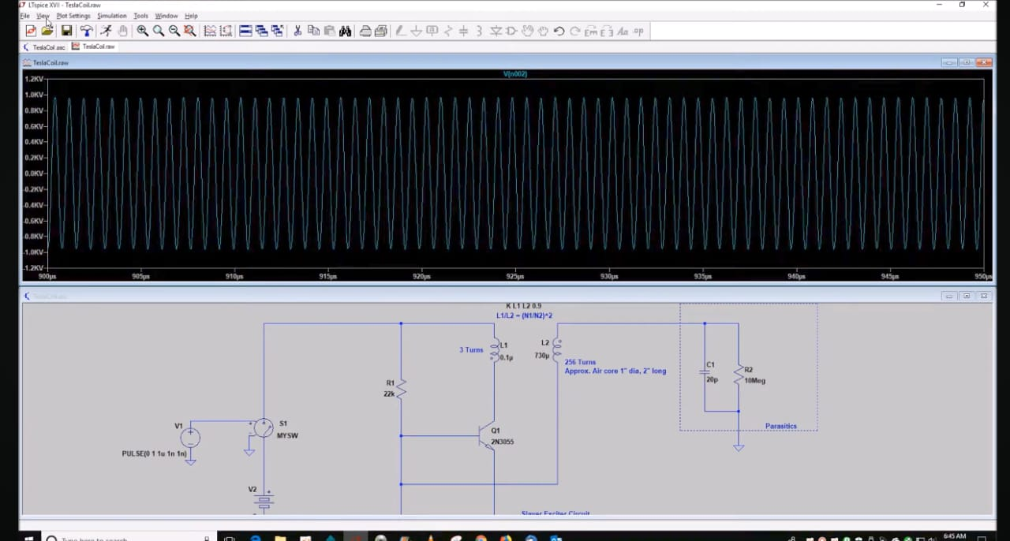
CONCLUSION:
We are able to generate high voltage with high frequency and it can be used for testing the
apparatus for Switching surges.
It can also be used for study of visual corona and ionization of the gases under the
electrical stress

Slide 11
CONCLUSION
We are able to generate high voltage with high frequency
and it can be used for testing the apparatus for switching surges
It can also be used for study of visual corona and ionization of the gases
Under the electrical stress.

